Slide 1
LESSON 25.02 · WEEK 25
Investigation: Protect
a Park Proposal
NGSS 3-LS4-4 · Earth & Human Activity / ETS1-1

Slide 2
OUR BIG QUESTION
Think About This...
"If a park habitat is being damaged, how do you figure out what to do — and how do you convince others that your plan will actually help?"
Hold this question in your mind as you work. By the end, your proposal should be your answer.

Slide 3
OBJECTIVES
I Can Statements
I can identify a threat to a park habitat and explain why it matters.
I can write a habitat protection proposal that includes a problem, evidence, solution, and criteria.
I can use evidence to make a claim about why my proposed solution would reduce harm.
Notes:
Readiness map: I Can #1 (identify a threat, explain why it matters) rehearsed in Section 1 (Slide 10) and the tap-a-threat-zone diagram (Slide 12). I Can #2 (write a proposal with problem/evidence/solution/criteria) rehearsed in Section 2 (Slide 11), the Proposal Planning Chart (Slides 18-19), and Record Your Thinking (Slide 20). I Can #3 (use evidence to make a claim) rehearsed in the Strengthen Your Claim step (Slide 17), Self-Check Q2-Q3 (Slides 24-26), and the formal Write & Explain (Slide 28). All three assessed in Self-Check (Slides 22-26) and Assignment (Slides 27-29).

Slide 4
YOU'LL NEED
Materials
Science notebook
Pencil & colored pencils
Proposal Planning Chart

Slide 5
NOTICE & WONDER
What Do You Already Know?
Think about a wild place you care about — a forest, a beach, a park, a swamp. Now imagine something is hurting it. Before we start today's work, take a minute to think about what you already know.
WHAT DO YOU NOTICE? WHAT DO YOU WONDER?
What is one thing that could damage a wild habitat? Write it down. Then write 1 question: What would you do about it if you were in charge?

Slide 6
WORD WALL
Key Vocabulary — Part 1
Habitat
The place where a plant or animal lives and gets the food, water, and shelter it needs to survive.
Threat
A danger that could harm a living thing or damage the place where it lives.
Conservation
Protecting nature so that plants, animals, and ecosystems stay healthy for the future.

Slide 7
WORD WALL
Key Vocabulary — Part 2
Proposal
A written plan that describes a problem and explains a solution that could fix it.
Criteria
The list of things a solution needs to do to count as successful — what "working" looks like.
Evidence
Facts, observations, or data that support an idea or show that something is true.

Slide 8
COPY THIS DOWN
In Your Science Notebook
"A habitat protection proposal explains the problem, describes the solution, and uses evidence to show why it would work."

Slide 9
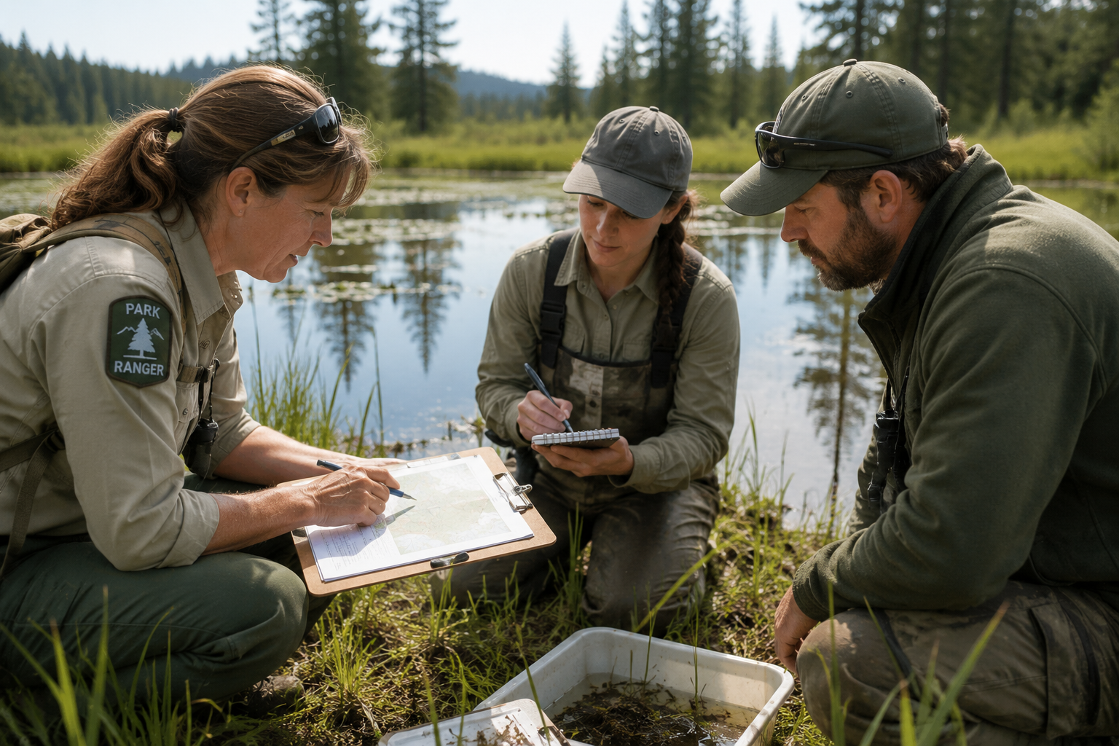
PHOTO · CONSERVATION IN ACTION
Scientists Write Plans, Not Just Notice Problems
A habitat protection proposal gives decision-makers the information they need to take action.
Scientists don't just notice problems — they write plans. A habitat protection proposal gives decision-makers the information they need to take action.

Slide 10
THE LESSON · SECTION 1
What Threatens a Habitat?
Every habitat has things that could hurt it. Threats can come from pollution washing into a river, invasive plants crowding out native ones, or too many visitors trampling a fragile marsh. Sometimes the threat is slow — habitat loss from roads and buildings creeping into wild land. Scientists notice patterns over time: counting species, measuring water quality, tracking which plants are disappearing.
SCIENTIST TALK
If you walked into a park and noticed the water looked brown and the fish were gone, what would you want to know next?

Slide 11
THE LESSON · SECTION 2
The Four Parts of a Proposal
A habitat protection proposal has four parts:
The Problem — What's happening and why it matters.
The Evidence — The facts and observations that prove the problem is real.
The Solution — What you think should be done.
The Criteria — How you'll know if it worked.
A proposal without evidence is just an opinion. With evidence, it becomes a case.

Slide 12
TAP A THREAT ZONE
Five Common Threats
The interactive shows five common threats that conservation scientists study and write proposals to address. Each one needs a different kind of solution.
Pollution
Invasive Species
Habitat Loss
Over-Visitation
Climate Threats

Slide 13
KEY CONCEPT
Evidence Turns Opinion Into a Case
KEY CONCEPT
When a habitat is threatened, scientists and citizens write protection proposals. A strong proposal names the problem, presents evidence, describes a solution, and explains how you'll know if it worked.
A proposal without evidence is just an opinion. Evidence turns an opinion into a case.

Slide 14
AMAZING NATURE FACT
The Everglades Restoration Project
The Florida Everglades Restoration Project is one of the largest habitat protection efforts in history — covering 18,000 square miles. Scientists spent 30 years gathering evidence before the plan was approved. Their proposals convinced the government to spend more than $10 billion to restore the water flow.

Slide 15
CURIOUS? GO DEEPER
Why Proposals Matter So Much
Scientists who discover a problem can't fix it alone — they need resources, permission, and people to do the work. A well-written proposal communicates urgency to the people with power to act. In the 1960s, Rachel Carson wrote 'Silent Spring' about pesticides killing birds. It had evidence, vivid descriptions, and a clear argument. It changed how the country thought about chemical pollution and led to the creation of the EPA.
SCIENTIST TALK
What made Rachel Carson's book so convincing? Think about the difference between just saying something is wrong and proving it.

Slide 16
ENGINEERING CHALLENGE
Write Your Habitat Protection Proposal
Identify a real threat, then design and argue for a solution. Pick Your Park Problem — choose one threat to focus on:
Pollution
Invasive Species
Habitat Loss
Over-Visitation
Climate Threats

Slide 17
REHEARSAL · BUILD YOUR PROPOSAL
Gather, Design, Set, Strengthen
Gather What You Know: In the Evidence row, write at least two things you know about this threat — specific facts, not just 'it's bad.'
Design Your Solution: In the Solution row, write what you'd actually do. Think about who would help and what resources you'd need.
Set Your Criteria: Describe what success would look like — something you could measure or observe.
Strengthen Your Claim: Write one sentence that starts "I believe this proposal would work because…" — this is your claim.

Slide 18
COPY THIS CHART
Proposal Planning Chart
Part of Proposal | What I'll Write
The Problem — What's happening? | write here…
My Evidence — How do I know it's real? | write here…
My Solution — What would I do? | write here…
Criteria for Success — How will I know it worked? | write here…
My Claim — "I believe this would work because…" | write here…

Slide 19
THINK LIKE A SCIENTIST
Every Solution Has Trade-Offs
SCIENTIST TALK
A solution that costs nothing and fixes everything in one week is probably too good to be true. What limits or trade-offs does your solution have? What might be hard about making it actually happen?

Slide 20
REHEARSAL · RECORD YOUR THINKING
Organize and Defend Your Proposal
Write the Problem section — name the habitat, the threat, and the effect on plants or animals.
Write the Evidence section — list at least two pieces of evidence and explain why each shows the threat is real.
Write the Solution + Criteria section — explain what you'd do and how you'd know it worked. Sketch your solution, labeling at least two parts.
Tell the whole story of your proposal out loud — from problem to evidence to solution.

Slide 21
DISCUSSION · THINK IT THROUGH
Think Through Each Question On Your Own
What specific evidence makes you confident that your chosen threat is a real problem — not just something that might happen someday?
What makes your solution better than doing nothing at all? What would the habitat look like in 10 years if nobody acted?
What might go wrong with your solution? What's one thing you'd change if you could redesign it?
If a park ranger read your proposal, what question do you think they'd ask you — and how would you answer it?

Slide 22
QUICK SELF-CHECK · QUESTION 1
What Is a Habitat?
What is a habitat?
A) The place where a plant or animal lives and gets the food, water, and shelter it needs
B) A plan that scientists write to protect nature
C) A list of rules for visitors at a national park
WHAT DO YOU NOTICE? WHAT DO YOU WONDER?
What do you notice in this scenario that helps you decide? What do you wonder about before you answer?
CHAT
Think back to the vocab card. Habitat is about a living thing's home, not a written plan or a rulebook.
Notes:
Tests core vocabulary distinction between habitat, proposal, and park rules.

Slide 23
QUICK SELF-CHECK · QUESTION 1
What Is a Habitat? — Answer
Correct: A — A habitat is the place where a plant or animal lives and finds what it needs to survive.
Notes:
Reinforce that habitat refers to the living space itself.

Slide 24
QUICK SELF-CHECK · QUESTION 2
What Makes a Strong Proposal?
Which best describes what makes a habitat protection proposal strong?
A) It only lists species that live in the park
B) It connects the problem to real evidence and explains a specific solution
C) It just says the park needs to be protected
WHAT DO YOU NOTICE? WHAT DO YOU WONDER?
What do you notice in this scenario that helps you decide? What do you wonder about before you answer?
CHAT
A proposal needs both evidence AND a solution. A drawing or a species list alone doesn't explain what to do or why it would help.
Notes:
Tests understanding of proposal structure: problem + evidence + solution.

Slide 25
QUICK SELF-CHECK · QUESTION 2
What Makes a Strong Proposal? — Answer
Correct: B — A strong proposal always connects the problem to real evidence and explains a specific solution, not just what's wrong.
Notes:
Reinforce that evidence and a specific solution both must be present.

Slide 26
QUICK SELF-CHECK · QUESTION 3
Criteria for Success
Which of the following is the best example of a criteria for success in a habitat protection proposal?
A) "The park has many different animals living in it"
B) "We want to protect the Everglades wetlands"
C) "The number of nesting birds increases within two years of the cleanup"
WHAT DO YOU NOTICE? WHAT DO YOU WONDER?
What do you notice in this scenario that helps you decide? What do you wonder about before you answer?
CHAT
Criteria for success should be specific and measurable, something you can actually observe and count. 'We want to protect' is a goal, not a measure of success.
Notes:
Tests distinguishing measurable criteria from vague goals or statements of fact.

Slide 27
QUICK SELF-CHECK · QUESTION 3
Criteria for Success — Answer
Correct: C — Criteria need to be specific and measurable. 'Nesting birds increase within two years' is something you can actually check.
Notes:
Reinforce that criteria must be observable and time-bound, not just aspirational.

Slide 28
ASSIGNMENT · PART A
Identify and Classify
In your notebook: 1) List three different threats that could damage a national park habitat, with one sentence about each. 2) For each threat, write one type of evidence a scientist could use to show the threat is real. 3) Circle the threat your proposal is about.

Slide 29
ASSIGNMENT · PART B & WRITE AND EXPLAIN
Short Answer + Defend Your Proposal
Part B (complete sentences): 1) What problem did you describe in your proposal? Be specific. 2) Why is evidence important in a habitat protection proposal? Give a specific example. 3) What criteria did you choose? How would you know your solution is working?
WRITE & EXPLAIN — Explain your habitat protection proposal and make the case for why it would work.
Start with: "The threat I chose is ___, and I know it's a problem because…"
Then: "This evidence shows that…"
Finish with: "My solution would work because…"

Slide 30
ASSIGNMENT · PART C & SUBMISSION
Draw & Label + What to Turn In
Part C: Draw a simple map or diagram of your park habitat. Show (1) where the threat is happening, (2) where your solution would take place, and (3) at least two plants or animals that would be helped. Label all parts.
SUBMIT ON CANVAS — must include:
Completed Proposal Planning Chart with all five rows filled in
Part A and Part B answers identifying threats, evidence, and criteria
Write & Explain response using science vocabulary (habitat, threat, evidence, criteria)
Part C habitat diagram with labels showing threat, solution, and affected species

Slide 31
Great Work, Park Scientist!
Coming up next: properties of matter.
Lesson 26.01 · Properties of Matter

